Slide 1

Railway management System

Slide 2
Name of team members
Patel Deepkumar 20162171014
Patel Dhruv 20162171015
Patel Harsh 20162171016
Patel Harshil 20162171017

Slide 3
Proposed system : software specification
JBDC
Java

Slide 4
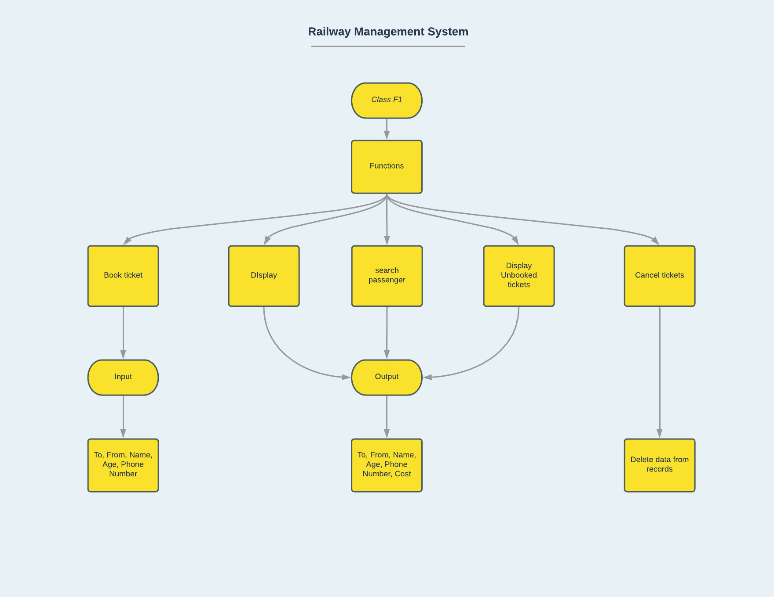
Flowchart

Slide 5
Java Concept Implemented
Abstact class
Interface
Constructor
Exception Handling
Inheritance
Jdbc

Slide 6
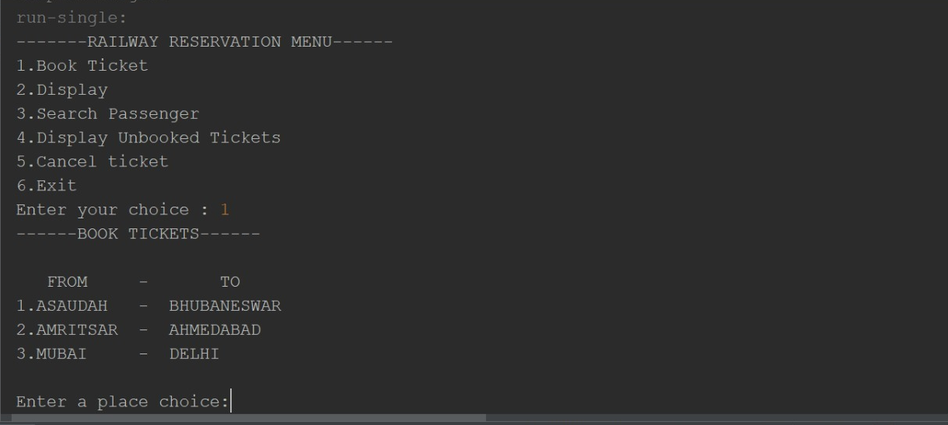
Main menu

Slide 7
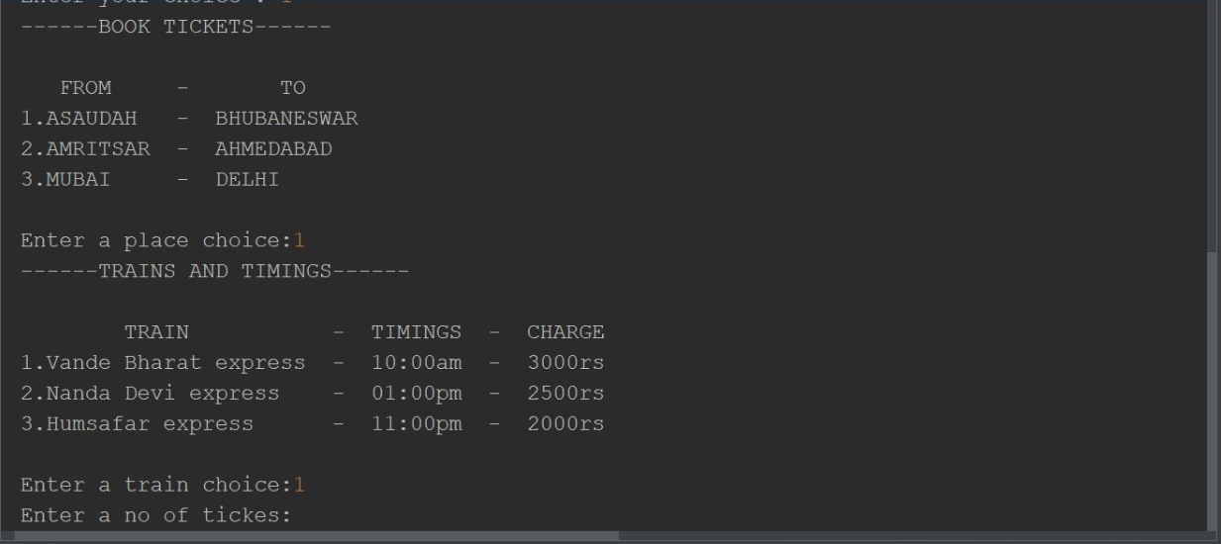
Ticket Booking

Slide 8
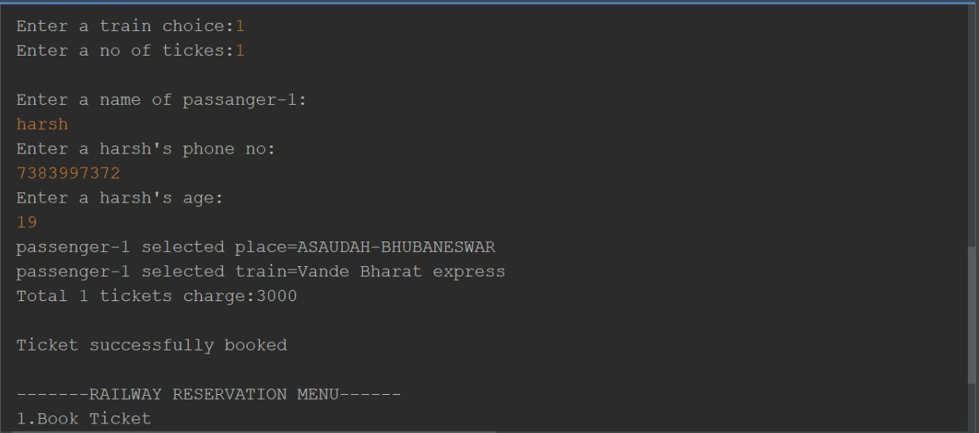

Slide 9
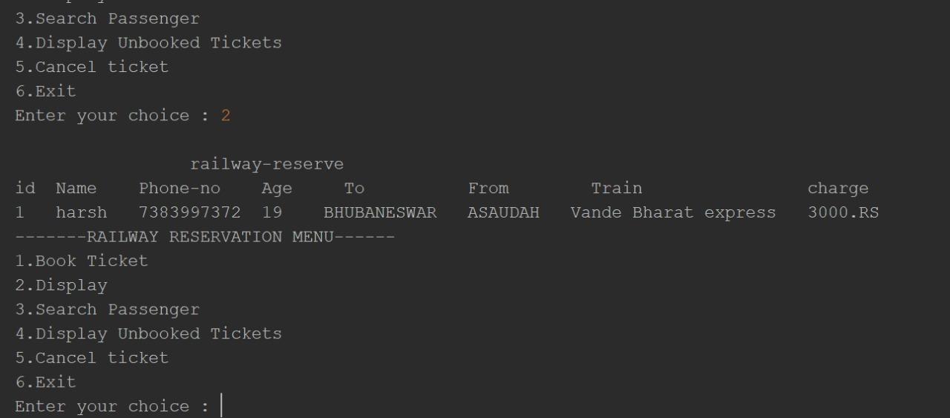
Display Ticket

Slide 10
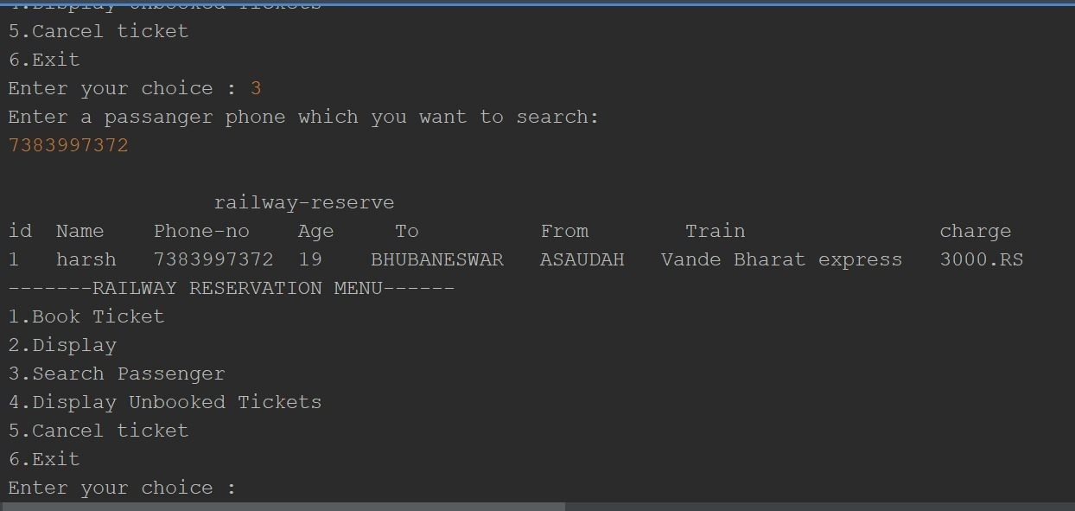
Search Ticket

Slide 11
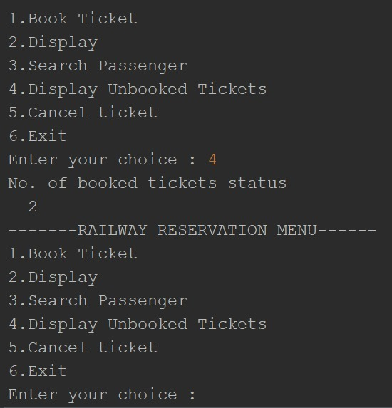
Display Available Tickets

Slide 12
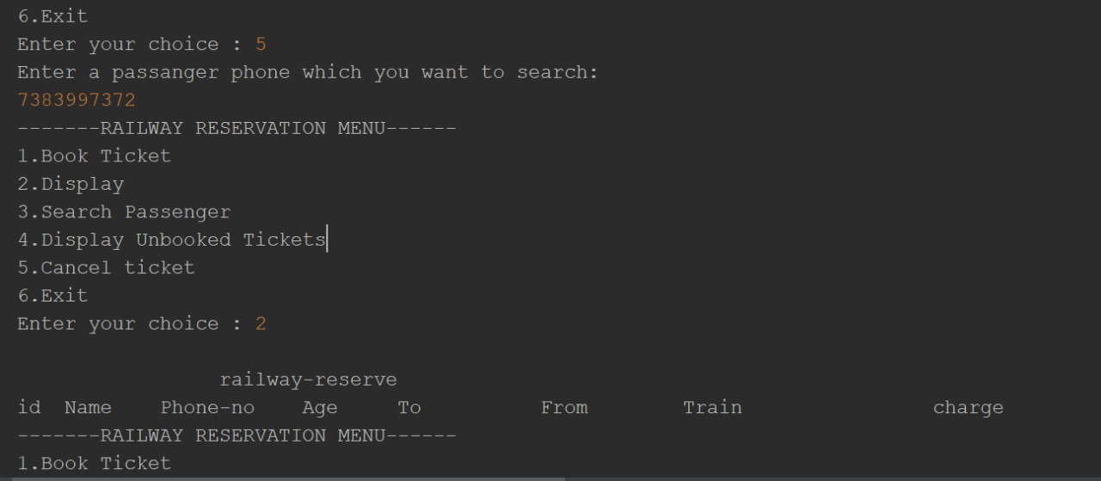
Display Cancelled Tickets

Slide 13
Future Updates
Live Tracking
Log-in and Registration Portal
Customer Feedback

